Slide 1

WHAT IS
THE ISSUE?

Slide 2
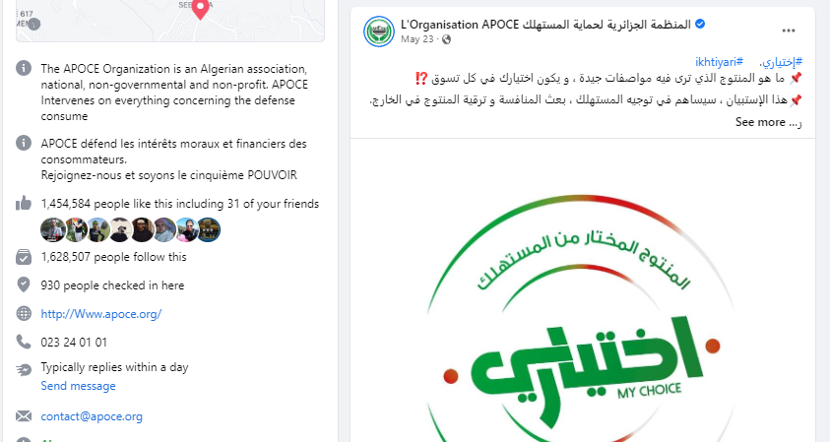

Slide 3
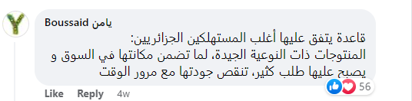
Source:Facebook page: APOCE

Slide 4
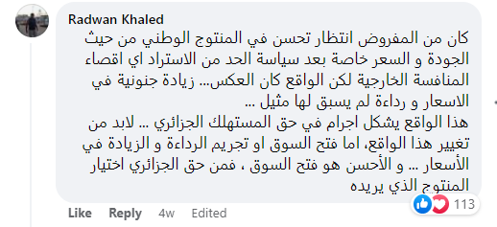
Source:Facebook page: APOCE

Slide 5
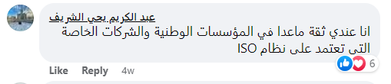
Source:Facebook page: APOCE

Slide 6
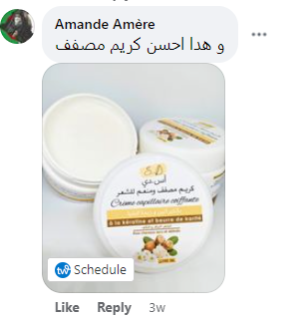
Source:Facebook page: APOCE

Slide 7
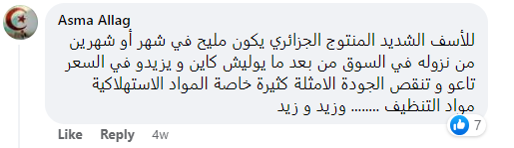
Source:Facebook page: APOCE

Slide 8
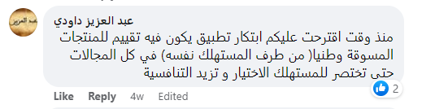
Source:Facebook page: APOCE

Slide 9
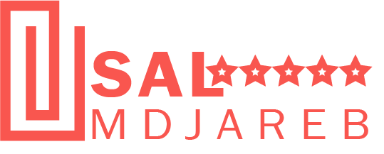


Grow with Sal M’djareb reviews.
Manage Reviews Seamlessly Anytime. Anyday.

Slide 10

Agenda
SECTIONS
Executive Summary SAL MDJAREB Technology SAL MDJAREB Algeria: Investment Case and Business Plan SAL MDJAREB Operating Model Appendix

Slide 11
Executive Summary
Challenge addressed
FMCGs BRANDS and services are in constant need of reliable informations to improve their performances
WOM information still the main source of information to brands’ owners to strategic decisions
Innovative solution proposed
SAL MDJAREB is an online platform for hosting consumers reviews and recommendation that generates genuine feedback for brands’ growth.
Medium & Long-term impact
Genuine reviews enhance brands credibility and drive improvements and growth.
Job creation IT / MARKETING
Advanced digitalisation of activities through innovation for the ultimate benefit of end-users/consumers,
Build solid and trustworthy community that enhance the interaction between consumers and brands through genuine feedback.
Improve consumers’ awareness about SAL MDJAREB.
Value proposition
For Brands : improved reputations and revenue, increased traffic, Enhance an exposer.
For Consumers: easy to decide, Browse Local brands, saved time and money.
For Market: competitive offering /expandable offering,

Slide 12
Agenda
SECTIONS
Executive Summary SAL MDJAREB Technology SAL MDJAREB Algeria: Investment Case and Business Plan SAL MDJAREB Operating Model Appendix

Slide 13






Sal Mdjareb
improve shopper experience, drive brand and service performance.
Shopper and consumer reviews platform
Online Reviews
Market Research
Channel Understanding
Compliance
Tracking
Brand Recommendation
Brand, Consumer, Shopper, Channel understanding

Slide 14
Data is captured via ……….
Our sophisticated APIs that collect and analyze consumers reviews.

Slide 15
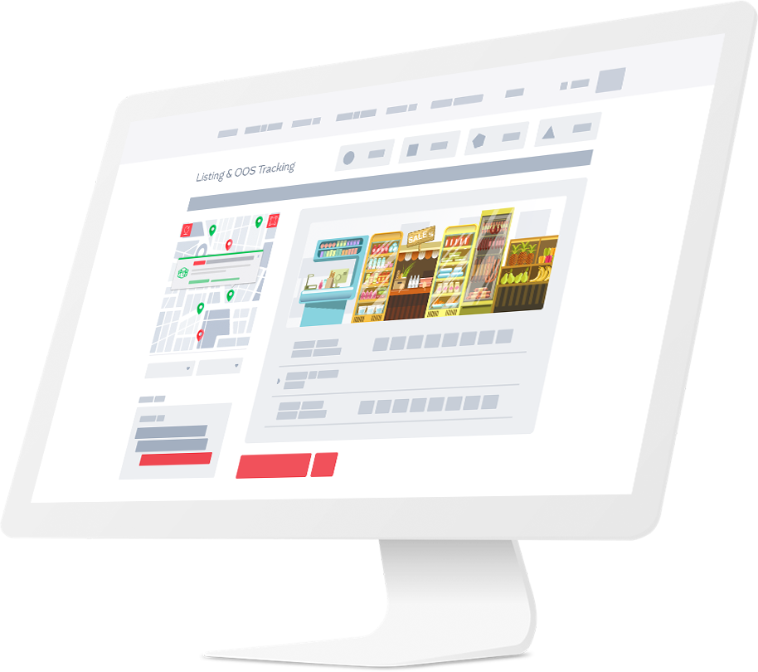

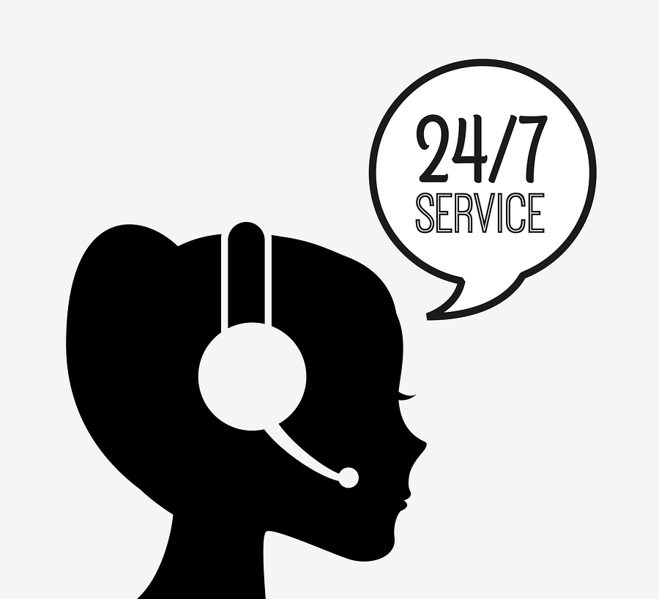
Key deliverables
1.Reviews by region.
2. Expert’s Help
3.Customer support

Slide 16

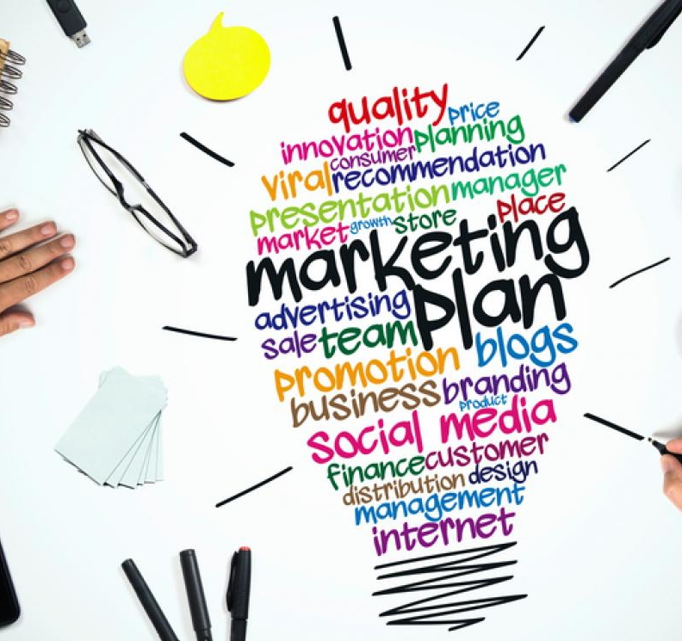


Key deliverables
4. Marketing tools
5. Brand Integration
6.Customized research reports

Slide 17



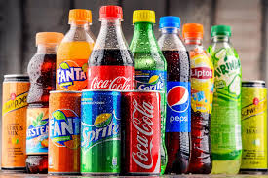

Sector experience
Household
Beverages
Liberal Professions
Personal Care & Beauty
IMF & Early Life Nutrition

Slide 18
Agenda
SECTIONS
Executive Summary SAL MDJAREB Technology SAL MDJAREB Algeria: Investment Case and Business Plan SAL MDJAREB Operating Model Appendix

Slide 19

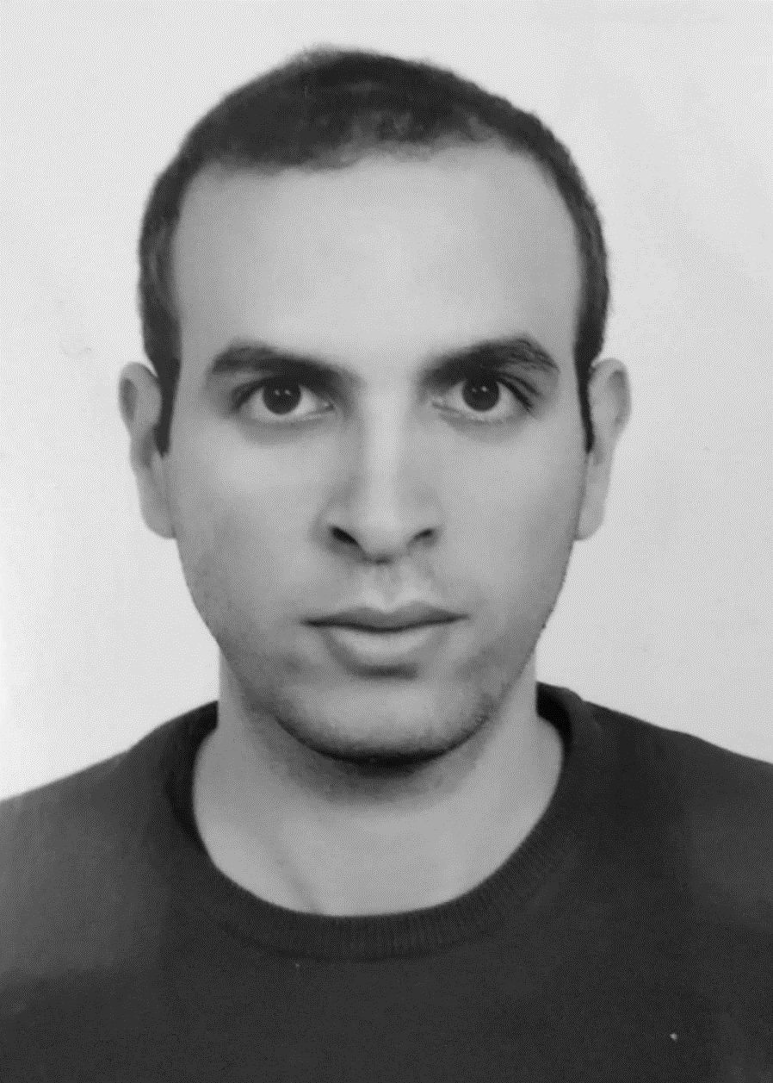
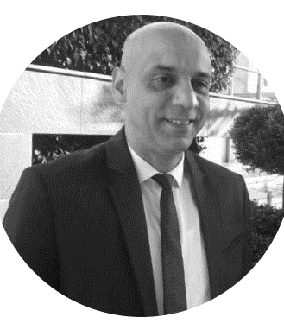
Founding Partners’ Profiles
HAMMOU BOUBAKER
CO-FOUNDER –SAL MDJAREB
MONTREAL UNIVERSITY,CANADA.
BAHANI BILLEL
CEO SAL MDJAREB
BLIDA UNIVERSITY , INSIM.
MOHMAED BENZOUAOUI
IT ENGINEER –SAL MDJAREB
ALGIERS UNIVERSITY,IEMN-IAE de Nantes

Slide 20
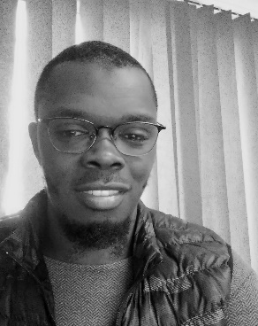
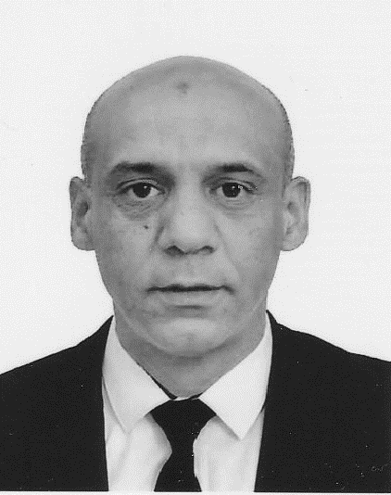
Organizational chart
CEO
CFO
COO
FINANCIAL CONTROLLER
FINANCAL CONTROLLER
CTO
Community Manager
CCOMMERCIAL DIRECTOR
CTO
CM
Head of Sales
Back- End system Manager
Mobil App Coordinator
Help desk and CRM
Vendor Experience Manager
IOT
Hub Algiers
Sales Dept
reviewers

Slide 21
Economic Model
Sal Mdjareb offers to clients a diverse portfolio of Consumer information including:
Information on rating Brands, services and other sectors
Market research studies
Brand performance and optimization
Information captures from any locations are targeting several industries:
FMCG sector (Fast Moving Consumer Goods)
Automotive industry
Pharmaceutical and para-pharmaceutical
+
Revenue Stream | Description | Invoicing model
Collectable reviews customized by region | Our technology will allow you to collect customized reviews generated by consumers who have experienced your products. This service will allow to track trends by region to make better decision based on factual data. | Freemium
Customized research reports | With our artificial intelligence prowess , you can dive deep in your customer feedback to see trends and insights within your reviews. | Freemium
Experts’ Help | Our Company will guarantee you the support of experts specialized in your brand activity to get the most value possible from your consumers’ reviews. | Freemium
Marketing tools and assets | SAL MDJAREB give access to useful marketing tools like ADS, Widgets, SEO, Google ratings,Benchmark, showcase,surveys…
Brand Integration Virtual and Physical | Aligning SAL MDJAREB Brands along with your brand will give consumers more reassurance and better conversion. | Freemium
Customer support | Our customer support will be at your disposal 24h/7 | Freemium

Slide 22

Competition
Sal Mdjareb is the sole player offering Brands and services reviews through its disruptive digital application in the target market
Players | Reviews & online panel | Real time information | Market Research
Sal madjareb
SmartRocket
Retail Zoom
Nielsen
Nielsen

Slide 23
Agenda
SECTIONS
Executive Summary SAL MDJAREB Technology SAL MDJAREB Algeria: Investment Case and Business Plan SAL MDJAREB Operating Model Appendix

Slide 24


Drivers of brand and business growth
Mental Availability
(Create a Compelling Expectation)
Physical Availability
(Match where & how consumers buy)
Salience
Consistent, memorable messaging
Cultivate distinctive brand assets
Build category relevance
PRESENCE - are you where you should be?
PROMINENCE – are you easy to find & buy?
RELEVANCE – are you relevant at the POS?
Performance
*Byron Sharp & Jenni Romaniuk: How Brands Grow

Slide 25


Service areas
PRESENCE - are you where you should be?
Build/ update/ clean target channel universes (all channels)
Investigate emerging/ unmeasured channels
Store attractiveness & categorisation measures
Brand & SKU listing
PROMINENCE – are you easy to find & buy?
Category SKU list building & planogram
Check quality of in store execution/ sales fundamentals
Check Parallel Imports
Category, brand & product in store performance & share
Category & brand POS materials usage & share
RELEVANCE – do you create & leverage relevance at POS?
Shopper experience (in store advocacy & purchase experience)
FOUNDATIONAL & STRATEGIC SUPPORT
Category purchase structure by channel, channel selection drivers & channel volumes
Compliance
Checking
Consumer Experience

Slide 26
Thank you
SAL MDJAREB
Location: Blida.
Tel: +213 554 990 201
Email: billel.Bahani@gmail.com
Website(Prototype):salmdjareb.vercel.app

